Slide 1
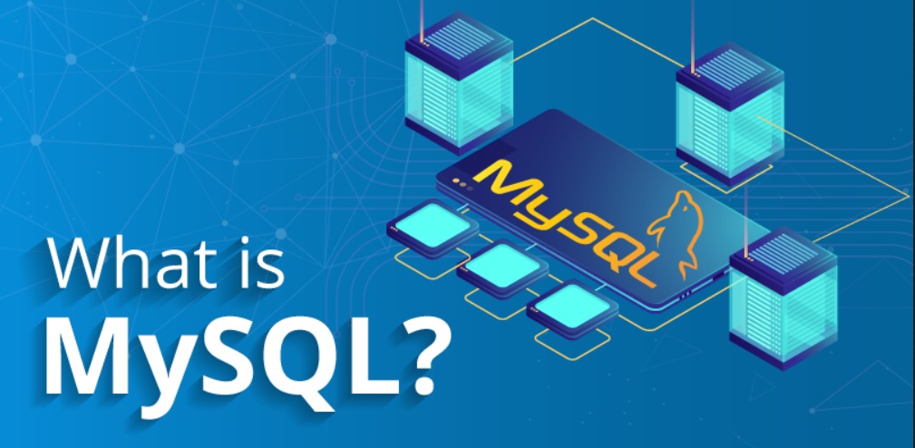
Introduction to Relational Databases - MySQL
https://www.edureka.co/blog/wp-content/uploads/2018/10/What-is-MySQL.png

Slide 2
Introduction to MySQL
MySQL is a database system used for developing web-based software applications.
MySQL used for both small and large applications.
MySQL is a relational database management system (RDBMS).
MySQL is fast, reliable, and flexible and easy to use.
MySQL supports standard SQL (Structured Query Language).
MySQL is free to download and use.
MySQL is presently developed, distributed, and supported by Oracle Corporation.
MySQL Written in C, C++.

Slide 3
Main Features of MySQL
MySQL server design is multi-layered with independent modules.
MySQL is fully multithreaded by using kernel threads. It can handle multiple CPUs if they are available.
MySQL provides transactional and non-transactional storage engines.
MySQL has a high-speed thread-based memory allocation system.
MySQL supports in-memory heap table.
MySQL Handles large databases.
MySQL Server works in client/server or embedded systems.
MySQL Works on many different platforms.

Slide 4
Who uses MySQL
Some of the most famous websites like Facebook, Wikipedia, Google (not for search), YouTube, Flickr.
Content Management Systems (CMS) like WordPress, Drupal, Joomla, phpBB etc.
A large number of web developers worldwide are using MySQL to develop web applications.

Slide 5
MySQL Setup
Windows
Installing MySQL on one window is relatively simple. You only need to download the MySQL installation package for the window version and install the installation package.
Under Windows, you can download the community edition from http://dev.mysql.com/downloads/ (Select the version of MySQL Community Server for the respective platform that you need.)
Ubuntu Linux
WAMP or XAMPP can also be installed; It comes with MySQL database.
Under Ubuntu, you can install MySQL with the following command:sudo apt-get install mysql-server
The LAMP can also be installed; it comes with the MySQL database.

Slide 6
Relational DataBase Management System (RDBMS)
A Relational DataBase Management System (RDBMS) is a software that −
Enables you to implement a database with tables, columns and indexes.
Guarantees the Referential Integrity between rows of various tables.
Updates the indexes automatically.
Interprets an SQL query and combines information from various tables.

Slide 7
RDBMS Terminology
Before we proceed to explain the MySQL database system, let us revise a few definitions related to the database.
Database − A database is a collection of tables, with related data.
Table − A table is a matrix with data. A table in a database looks like a simple spreadsheet.
Column − One column (data element) contains data of one and the same kind, for example the column postcode.
Row − A row (= tuple, entry or record) is a group of related data, for example the data of one subscription.

Slide 8
RDBMS Terminology
Redundancy − Storing data twice, redundantly to make the system faster.
Primary Key − A primary key is unique. A key value can not occur twice in one table. With a key, you can only find one row.
Foreign Key − A foreign key is the linking pin between two tables.
Compound Key − A compound key (composite key) is a key that consists of multiple columns, because one column is not sufficiently unique.
Index − An index in a database resembles an index at the back of a book.
Referential Integrity − Referential Integrity makes sure that a foreign key value always points to an existing row.

Slide 9
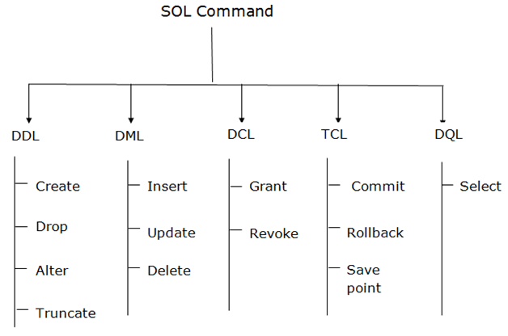
Important MySQL commands
Types of SQL Commands. There are five types of SQL commands: DDL, DML, DCL, TCL, and DQL.
https://www.javatpoint.com/dbms-sql-command

Slide 10
Administrative MySQL commands
USE Databasename − This will be used to select a database in the MySQL workarea.
SHOW DATABASES − Lists out the databases that are accessible by the MySQL DBMS.
SHOW TABLES − Shows the tables in the database once a database has been selected with the use command.

